Slide 1
Internet customer churn within a year
The objective is to identify why customers are disconnecting within a year's time of having services.
What are the similarities in internet customer disconnects?
Are the disconnects higher at a specific tenure?
Do monthly charges impact disconnects?

Slide 2
Identified variables in the dataset:
Average_MRC – Monthly cost for the customer
DISCO_REASON_GROUP – Reason for disconnect entered by the call center- changed to integer
DWELL_TYPE – Does the customer live in a single-family unit or in a multi-dwelling unit aka apartment – changed to integer
HOME_OWN_RENT – Indicator that the customer rents or owns their home – changed to integer
HSD_TIER – Speed of internet the customer has – grouped to integer
ZIP – Zip code of customer dwelling
SERVICE_ORDER_CREATED_DATE – Date the customer signed up for services
SERVICE_ORDER_ENDED_MONTH – Month that the customer disconnected
Added variable – Tenure – integer duration of active services

Slide 3
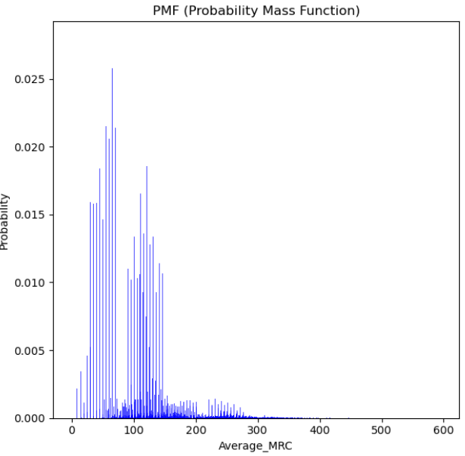
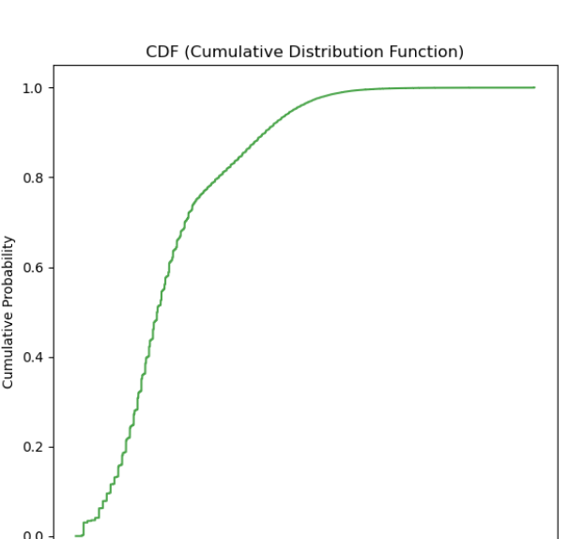
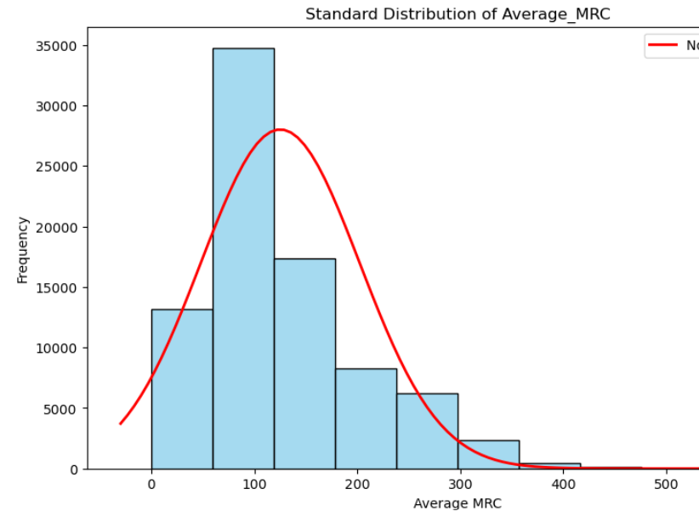
Average_MRC
Average monthly charges for internet customers in currency - FLOAT Variable
The mean value is: $125.18
The median value is: $105.95
The tail is skewed right because the mean value is greater than the median value.

Slide 4
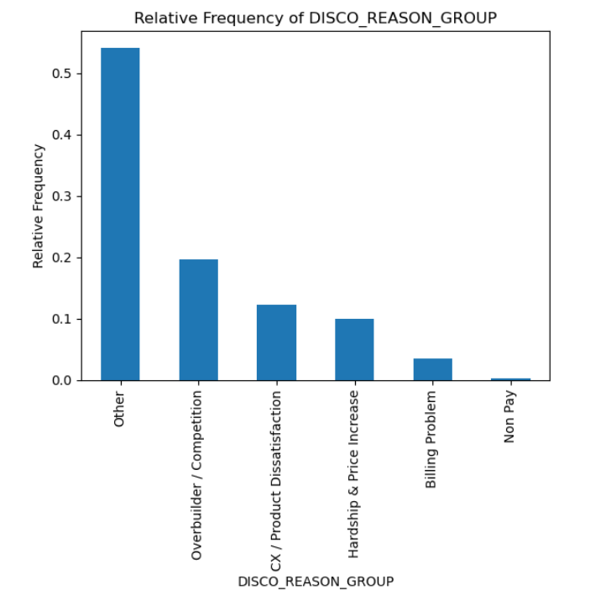
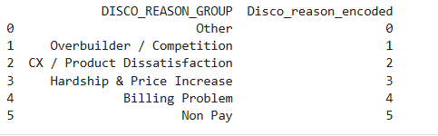
DISCO_REASON_GROUP
A categorical variable that indicates why a customer disconnected.
54% of customer who disconnect land in the “other” category
Encoded to integer

Slide 5
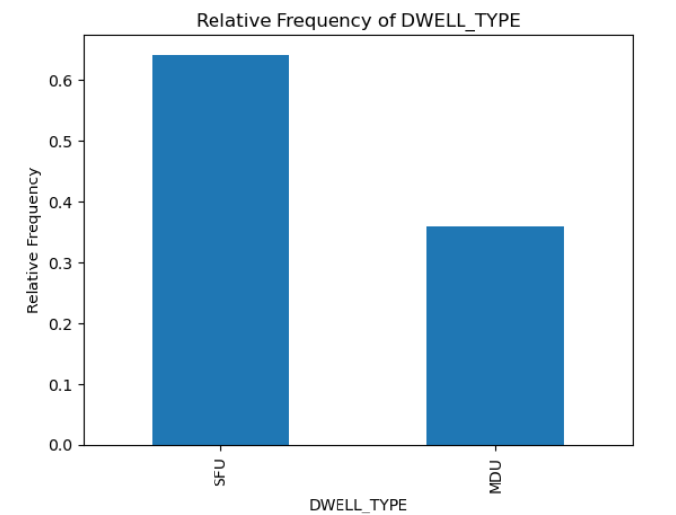

DWELL_TYPE
This variable is to identify whether a customer lives in a single-family unit or multi-family unit such as an apartment.
Categorical variable mapped and changed to binary. New variable names SFU – 1 to indicate customer lives in a single-family unit

Slide 6
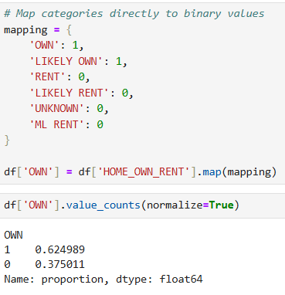
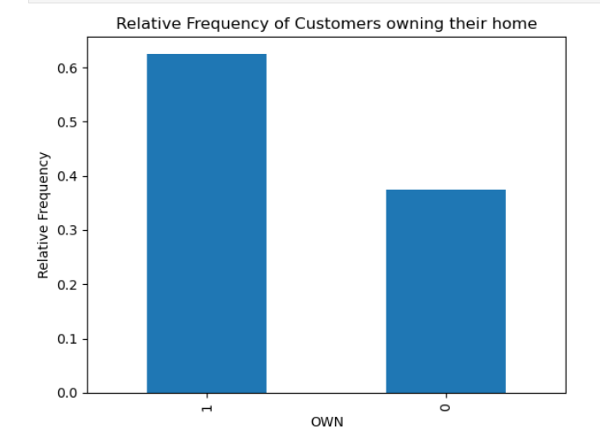
HOME_OWN_RENT
This variable is to identify whether a customer lives in a single-family unit or multi-family unit such as an apartment.
Categorical variable mapped and changed to binary. New variable name OWN – 1 to indicate customer owns their home

Slide 7
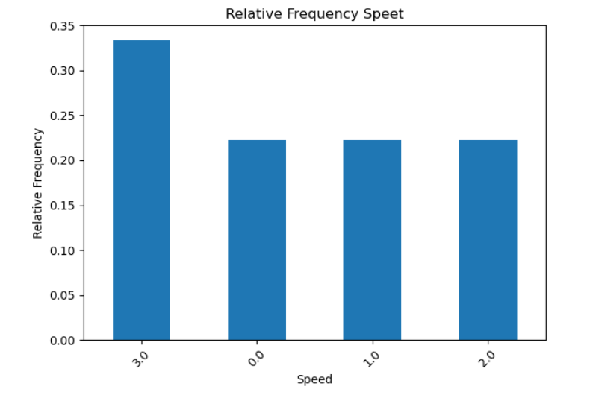
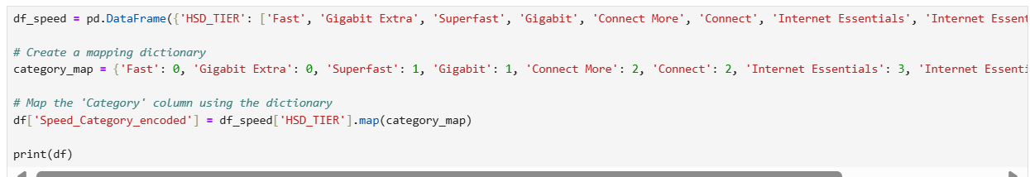
HSD_TIER
Categorical Variable of speed
Binned by likeness
Mapped to integer
The lower the number, the higher the speed

Slide 8
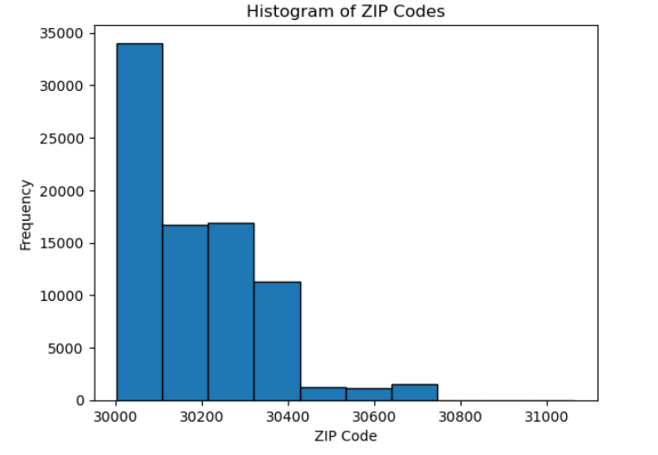
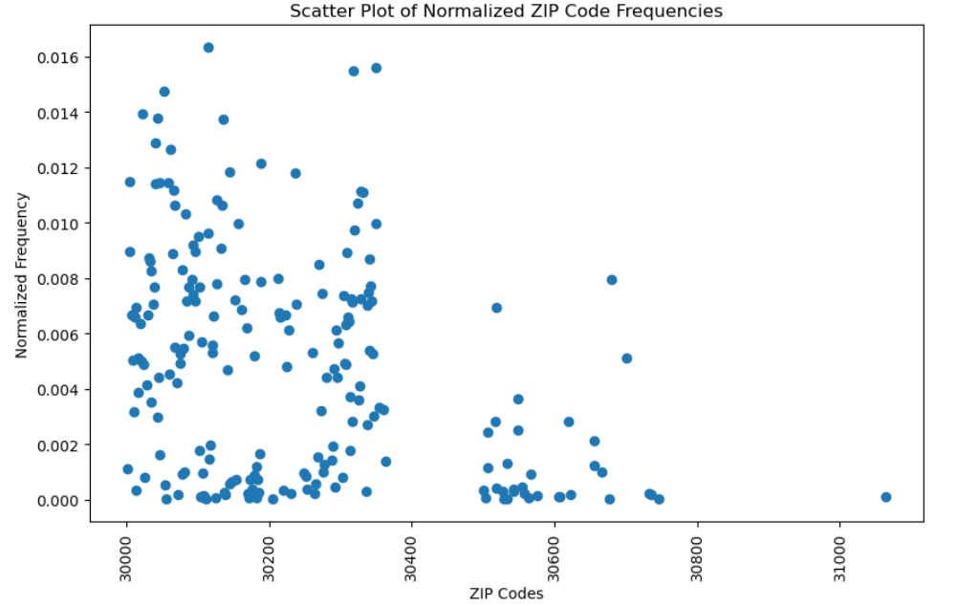
ZIP
The zip code that services have been disconnected.

Slide 9
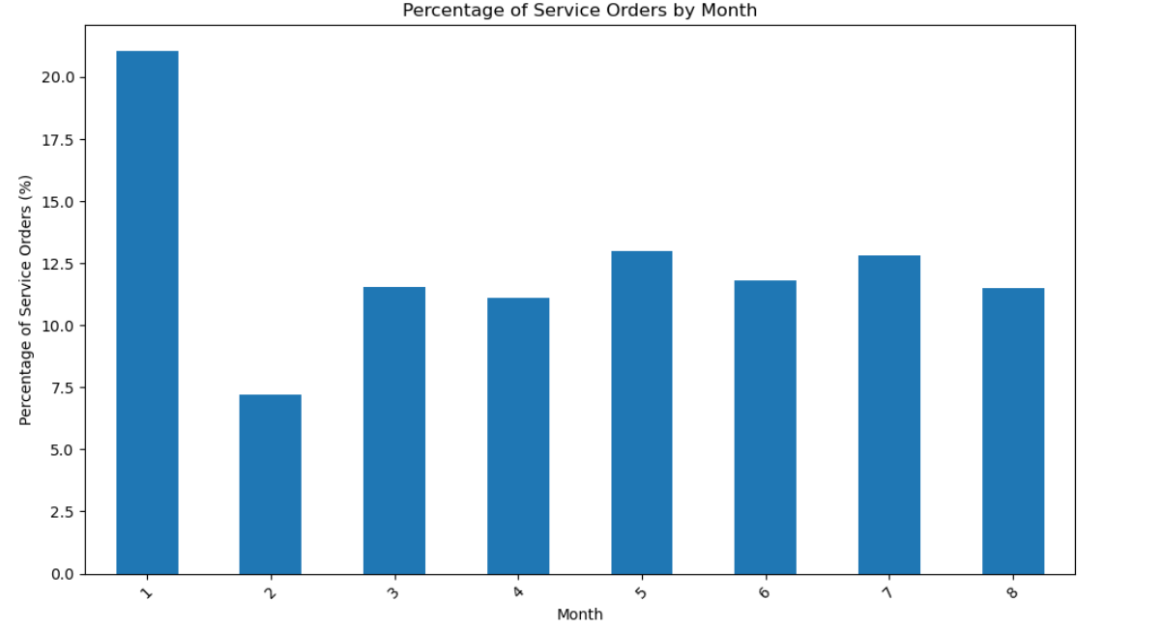
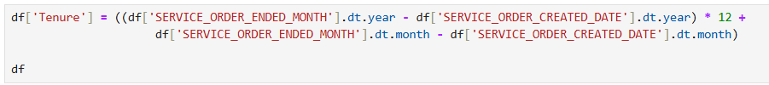
SERVICE_ORDER_CREATED_DATE And SERVICE_ORDER_ENDED_MONTH
Date variables– Converted to datetime and removed timestamp.
Used the two variables to calculate and add the Tenure integer variable.
All disconnects happened in the same month as this dataset was intended.

Slide 10
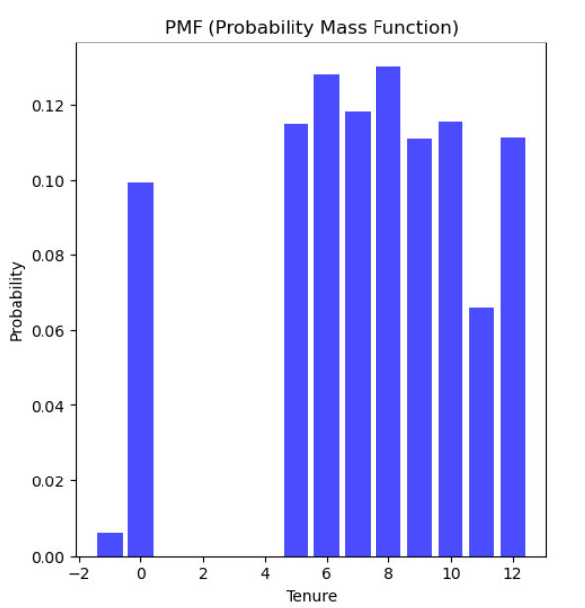
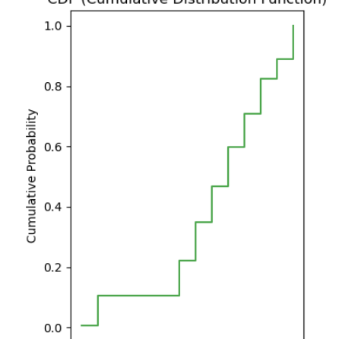
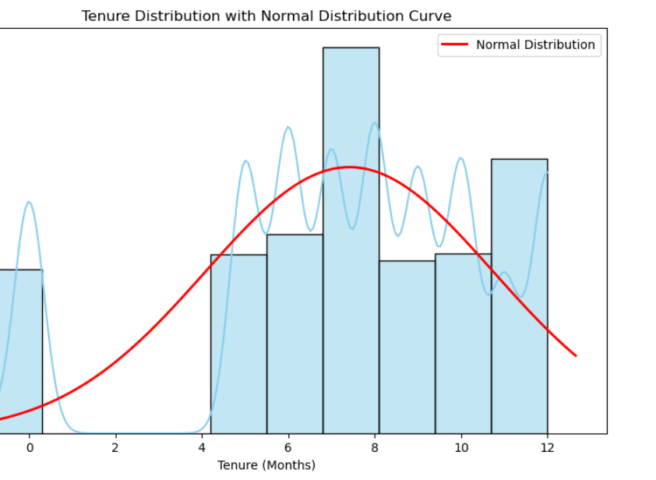
Tenure
Tenure is an integer created to identify the time in months of when the service started to when it ended.

Slide 11
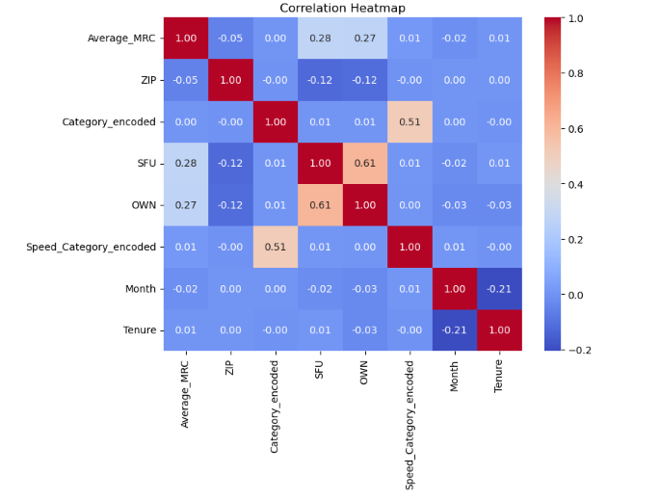
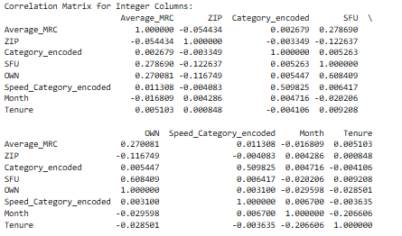
Correlation matrix
Completing a correlation matrix indicates that the correlation between SFU and Own is very high which makes sense because more people own single family units than apartments.
The correlation that I’ll be looking at is category_encoded_disco and speed_category.

Slide 12
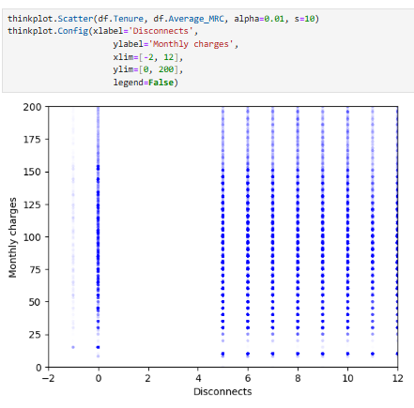
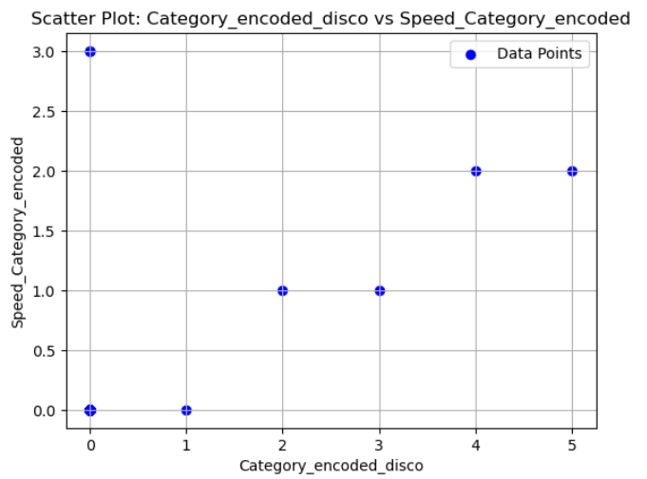
Scatter plots for 2 variables

Slide 13
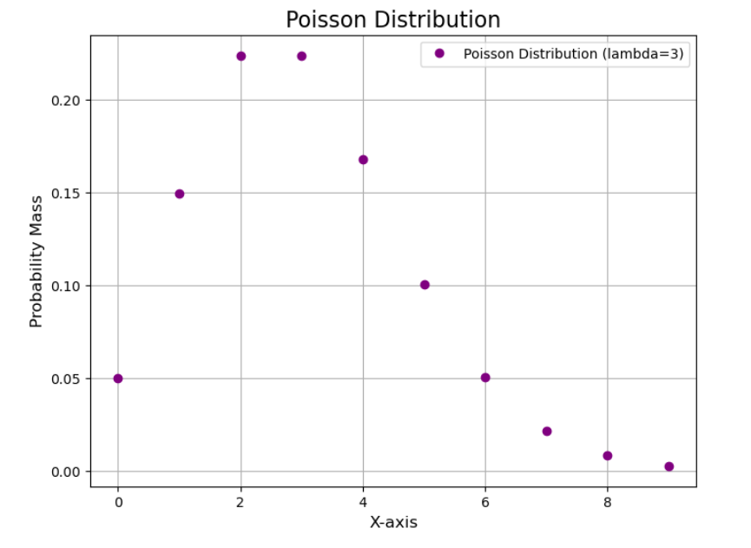
Poisson Distribution
This Poisson Distribution is skewed right. This distribution indicates that if we were to expect more cancellations, within this interval we could expect to see the distribution to standardize.

Slide 14
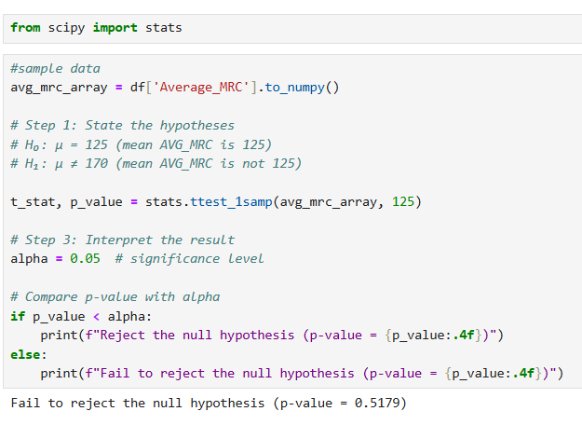
Hypothesis Testing - One-Sample t-Test
Used Average_MRC
Fail to reject the null hypothesis meaning there is not enough evidence to conclude that the mean Average_MRC is different from 125

Slide 15
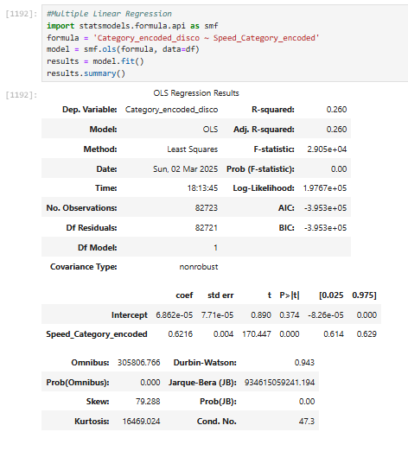
Multiple Linear Regression

Slide 16
Conclusion
The overall objective was to find a commonality as to why customers are disconnecting in their first year of service. The data set I used has several variables that I was able to explore. I felt that the most important variables were the tenure, disconnect reason and speed. It was interesting to see that so many customers disconnect within the first month and that monthly costs do not seem to have a large impact on disconnects. If I were to continue analyzing this, I think that this would be something that may be good to explore.
My initial assumptions about the disconnects was to focus on monthly costs and speed. While the monthly cost variable doesn’t seem to be much of a contributor, the speed does. Per the heat map, the correlation between speed and disconnect reason has the most impact for disconnects. Another eye-opening data discovery was that many of the disconnect reasons were “other”. Many of these were for customers who obtained services and disconnected services in one month which makes me wonder if there is a data discrepancy.
One of the challenges I faced is that I’m not experienced with completing an analysis from start to finish. I found myself duplicating efforts and having to re-create things due to different packages, and just not having enough knowledge yet. I feel that I may have limited the outcome due to the data set I chose. I felt that I had a very good grasp of the data by the end, but I struggled to keep a holistic view of the data. I continued going down rabbit holes that didn’t equate too much. While this course was wonderful, and I feel that I’ve got many of the concepts understood, I still lack the ability to put all the concepts together in an informative way. I believe as I continue learning and working with python, that I’ll get a better understanding of how all the concepts relate and when to use them.

